Slide 1
HAWKES LEARNING
Researching and Writing Responsibly

Slide 2
Ways to Integrate Sources
Summaries
Paraphrases
Quotations

Slide 3
Citing Sources
Within the text
List of Works Cited

Slide 4
Signal Phrase
present source information in sentence form
HAWKES LEARNING

Slide 5
Signal Phrase
present source information in sentence form
“According to ‘Age-Targeted Marketing,’ Billow writes….”
HAWKES LEARNING

Slide 6
Signal Phrase
present source information in sentence form
“According to ‘Age-Targeted Marketing,’ Billow writes….”
HAWKES LEARNING

Slide 7
In-text Citations
exactly where information is found
HAWKES LEARNING

Slide 8
In-text Citations
exactly where information is found
Author-page
(Brady 122-131)
(Greene 79)
HAWKES LEARNING

Slide 9
Works Cited
Located at end of paper and should be _____________.
titled
alphabetized
formatted
HAWKES LEARNING

Slide 10
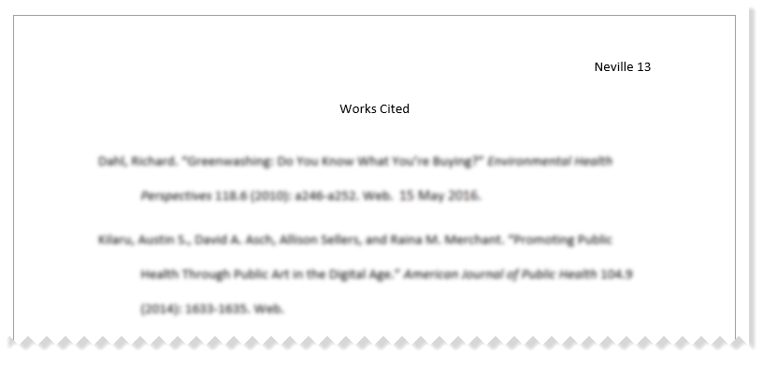
Works Cited

Slide 11
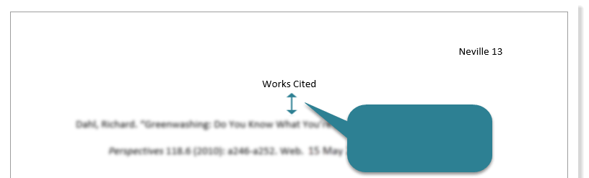
Works Cited
double-space

Slide 12
Works Cited
1”
Indent ½”

Slide 13
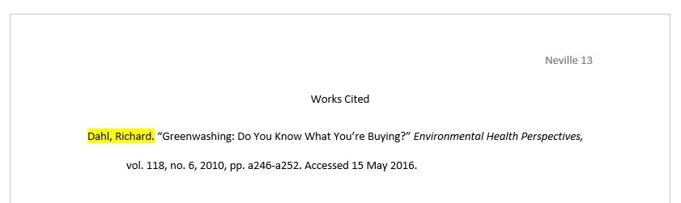
Works Cited

Slide 14
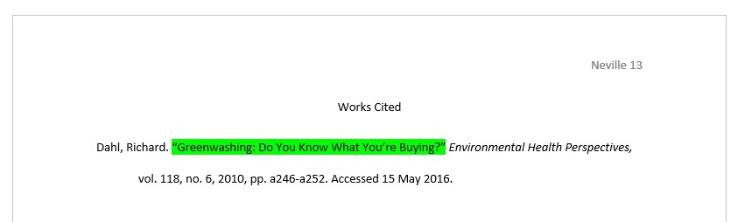
Works Cited

Slide 15
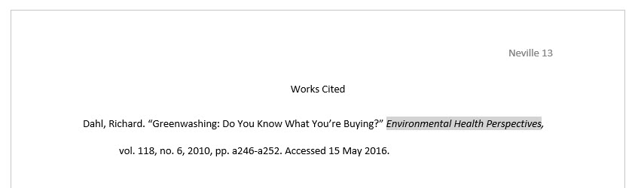
Works Cited

Slide 16
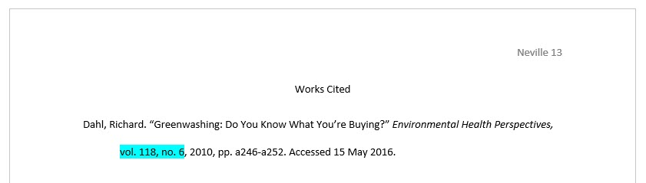
Works Cited

Slide 17
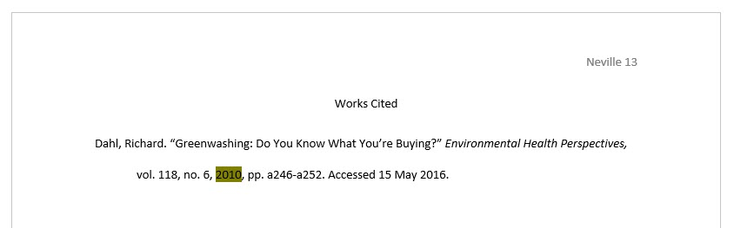
Works Cited

Slide 18
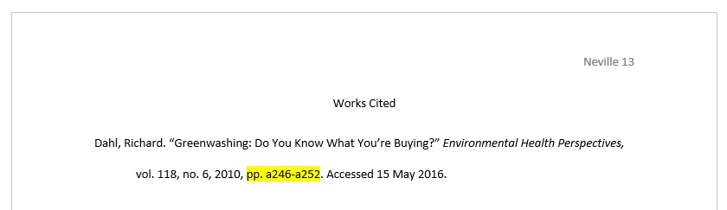
Works Cited

Slide 19
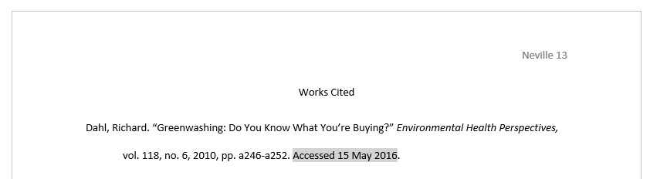
Works Cited

Slide 20
Summary
Large amount of information in a few sentences
broad overview

Slide 21
Summary
Written in own words
Borrowed ideas
→
→
Must cite
Tone
Show amount, time, or position.
HAWKES LEARNING

Slide 22
Paraphrase
➔
More in depth than a summary
➔
Refer to something specific
HAWKES LEARNING

Slide 23
To Avoid Plagiarism
Change
words
&
sentence structure
HAWKES LEARNING

Slide 24
Paraphrase Example
Original Source
Paraphrase
Marketing companies usually target children around the age when they begin to have influence over their
peers in order to reach more of the same demographic.
Advertisements are geared towards kids old enough to peer pressure. That way they have access to a larger spectrum of consumers.
→
HAWKES LEARNING

Slide 25
Quotations
Direct words of the source
Only used when author’s words are powerful and unique
“According to ‘Age-Targeted Marketing,” Billow writes….”

Slide 26
Quotations
Quote
Signal Phrase
Quotation marks
In-text Citation
HAWKES LEARNING

Slide 27
Example
Quotation with signal phrase and in-text citation:
In The Catcher and the Rye, Holden says, “I’m quite illiterate, but I read a lot” (Salinger 18).
HAWKES LEARNING

Slide 28
Integrating Sources
Summaries
Paraphrases
Quotations

Slide 29




HAWKES LEARNING

